Slide 1
What Is Your Job?

Slide 2
What is your job?
I am an actress.

Slide 3
What does an actress do?
I act.

Slide 4
What is your job?
I am
an actor.

Slide 5
What does an actor do?
I act.

Slide 6
What is your job?
I am a swimmer.

Slide 7
What does a swimmer do?
I swim.

Slide 8
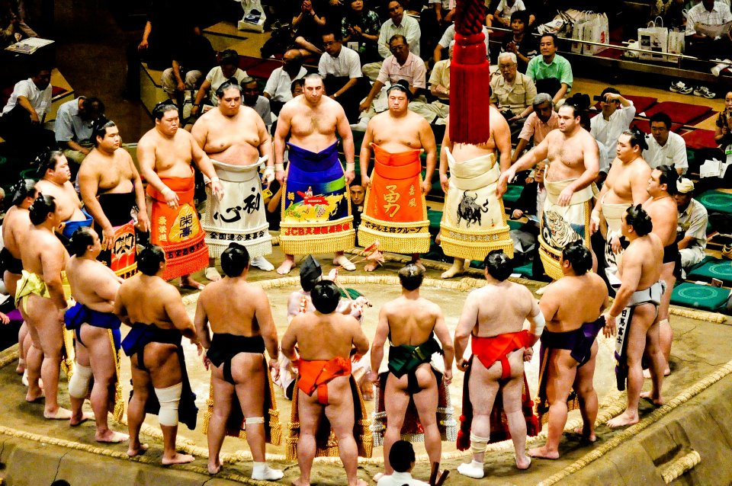
What is your job?
I am a sumo wrestler.

Slide 9
What does a sumo wrestler do?
I sumo wrestle.

Slide 10
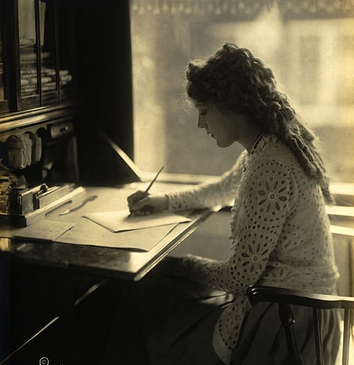
What is your job?
I am a writer.

Slide 11
What does a writer do?
I write.

Slide 12
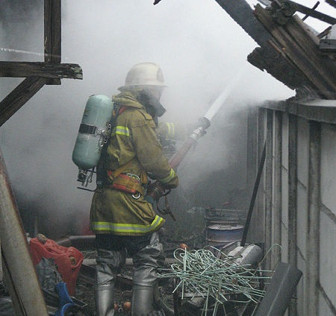
What is your job?
I am a firefighter.

Slide 13
What does a firefighter do?
I firefight.

Slide 14
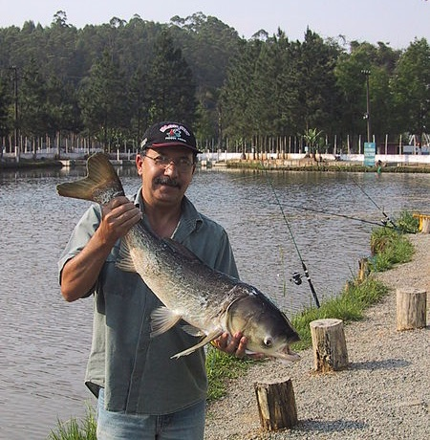
What is your job?
I am a fisher.

Slide 15
What does a fisher do?
I fish.

Slide 16
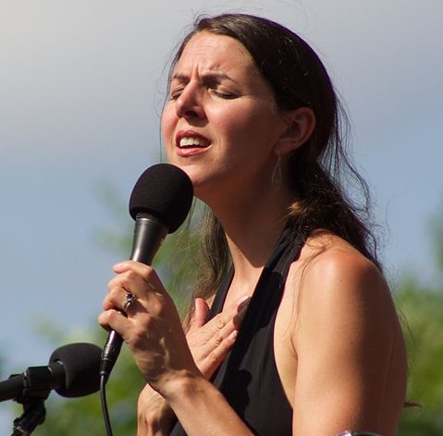
What is your job?
I am a singer.

Slide 17
What does a singer do?
I sing.

Slide 18
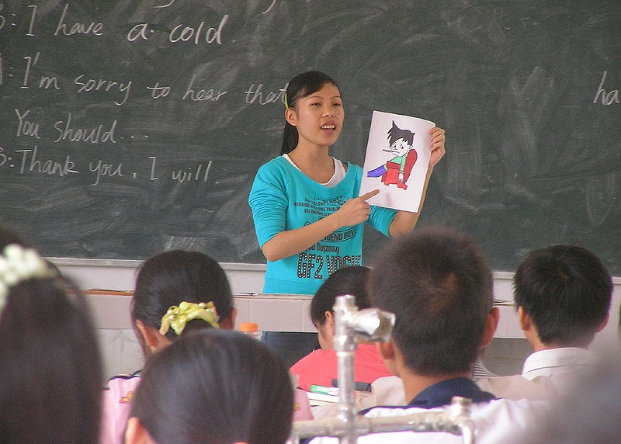
What is your job?
I am a teacher.

Slide 19
What does a teacher do?
I teach.

Slide 20
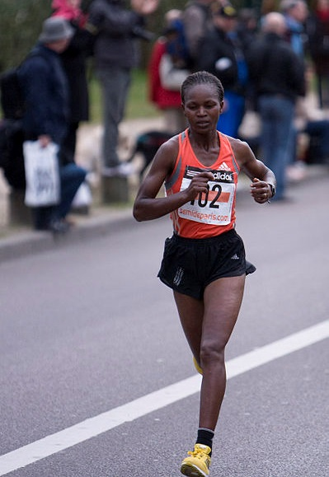
What is your job?
I am a runner.

Slide 21
What does a runner do?
I run.

Slide 22
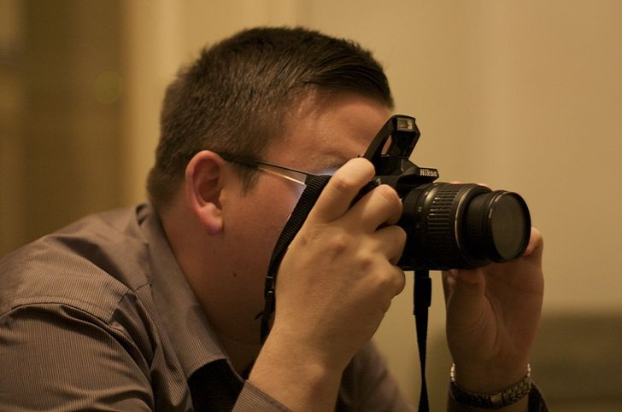
What is your job?
I am a photographer.

Slide 23
What does a photographer do ?
I take photographs.

Slide 24
What is your job?
I am a baseball player.

Slide 25
What does a baseball player do?
I play baseball.

Slide 26
I am a…
basketball player.

Slide 27
I am a…
soccer player.

Slide 28
Picture Resources
Jelijs, Michiel. Backstroke start at 2008 EC. https:// commons.wikimedia.org/wiki/Category:Competitive_swimming#/media/File:Backstroke_start_at_2008_EC.jpg
Antes, John Paul. Sumo Wrestling. https://commons. wikimedia.org/wiki/File:Sumo_Wrestling.jpg
Tokino. Japanese firefighter. http://commons.wikimedia. org /wiki/File:Japanese_firefighter.jpg
Magiccity. Pesquepag. http://commons.wikimedia.org/ wiki/File:Pesquepag.jpg
Smith, Richard E. HeatherMasse. https://commons. wikimedia.org/wiki/File:HeatherMasse.jpg
Adrignola. Student Teacher in China. http://commons. wikimedia.org/wiki/File:Student_teacher_in_China.jpg
Library of Congress. Mary Pickford writing at a desk. http://loc.gov/pictures/resource/ppmsca.18840/

